Slide 1
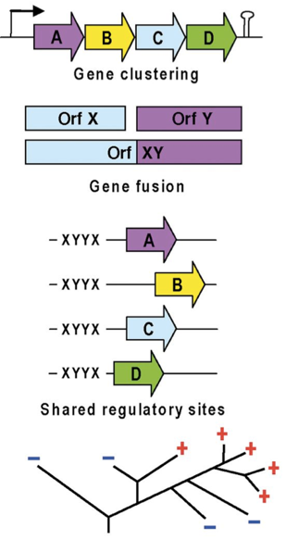
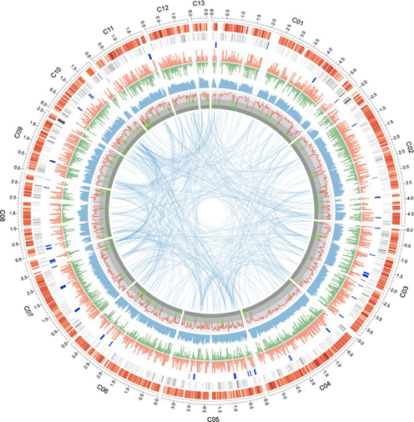
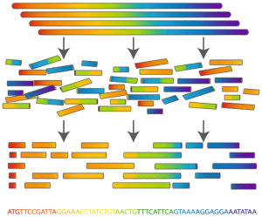
‘Sequence a Genome’ (SAGE)
Master Molecular Life Sciences
Philipp Engel
Department of Fundamental Microbiology, UNIL
Assembly
Annotation
Analysis

Slide 2
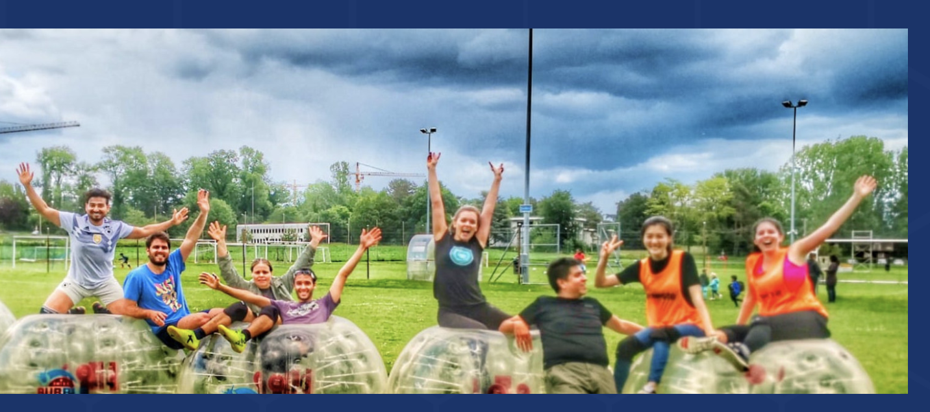
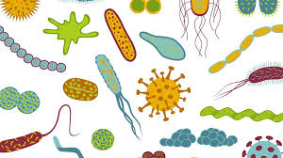

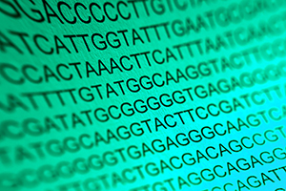
ENGEL Lab: Microbiome research
Bees
http://www.unil.ch/engellab
Cheese
Genomics
Metabolomics
Microbiology
Bioinformatics
Bee experiments
Cell culture
Phages
Human lung
Gut microbiota-host interactions
How do microbiomes function?
How have they evolved?
How do they impact the host?
Bioinformatics & Wet lab

Slide 3
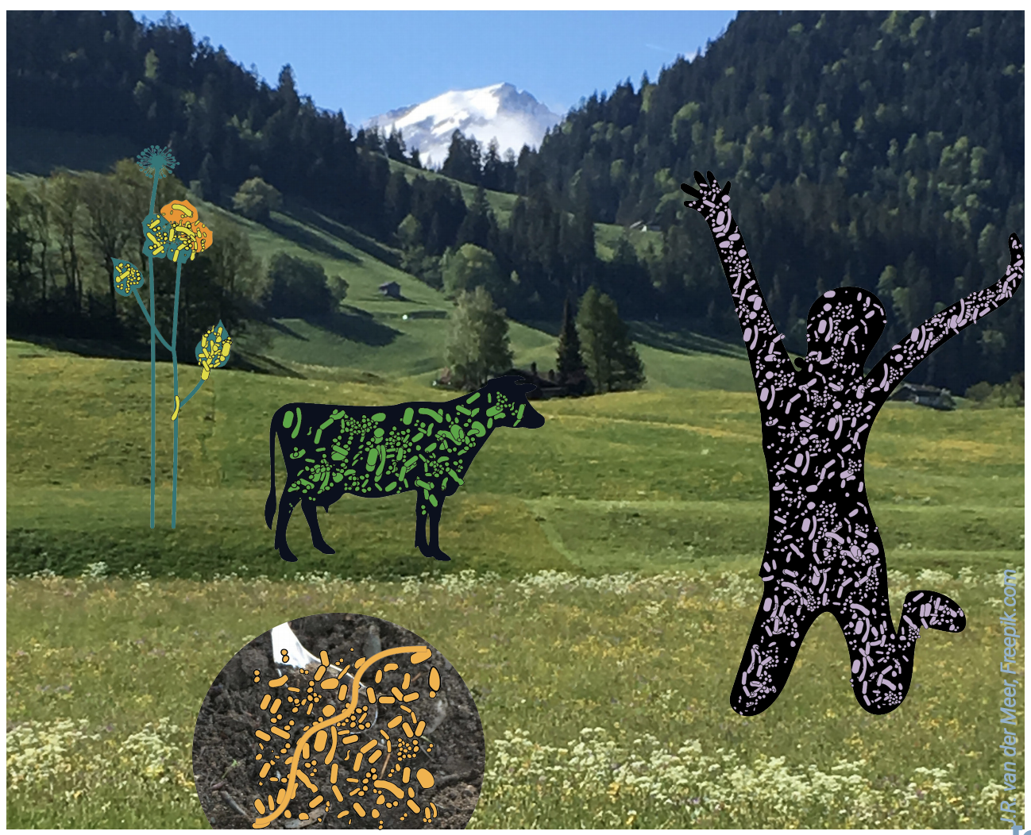
Natural microbial communities
Relevant for all aspects of life
Sequencing + bioinformatics provide new insights

Slide 4
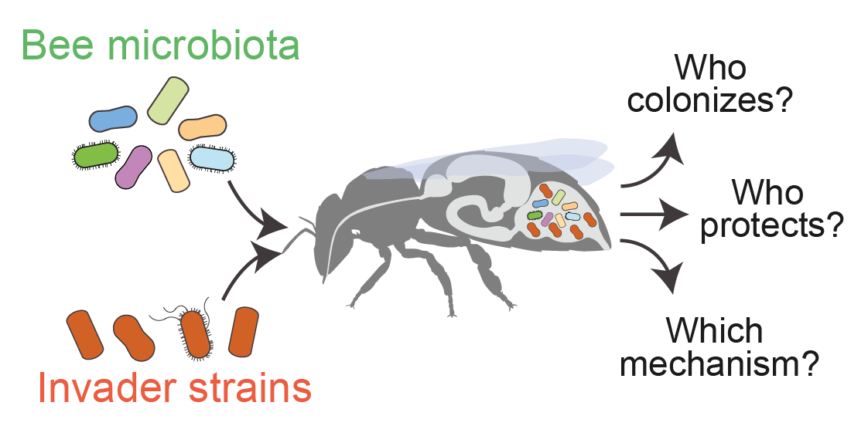
Course concept – Sequencing bacteria!
7th semester
(autumn)
Sequence isolate genomes
Illumina/ONT sequence reads
Environment
Genome assembly
Assembly analysis
Bacterial
colonies
Genome annotation
Isolate genomes
8th semester
(autumn)
Sequence entire microbiome
Environment
Community
changes over time
Functional
gene content
16S rRNA
sequencing
Shotgun
metagenomics
Training-through-research!

Slide 5
Objectives of this course (7th semester)
To learn theoretical aspects of (bacterial) genomics:
What are state-of-the-art sequencing technologies?
How is the quality of sequencing reads assessed?
How are genomes assembled?
How are genomes annotated?
What are general genomic characteristics, such as GC skew, GC content, ORFs and others?
What are homologs, paralogs, orthologs?

Slide 6
Objectives of this course (7th semester)
2. To acquire relevant technical skills in bioinformatics and genomics:
LINUX, command-line usage, R, R markdown
Handling ‘large’ datasets
Working on a ‘High-performance computing (HPC) cluster’
Processing of next-gen sequencing data
Performing read mappings
Analyzing genome assemblies and annotations
Documentation of bioinformatic analyses

Slide 7
Objectives of this course (7th semester)
https://www.import.io/post/why-data-scientist-is-being-called-the-sexiest-job-of-the-21st-century/

Slide 8
Credits and evaluation
Class counts for 3 credits per semester
--> equivalent to a time investment of 7 x 4h plus 2 days, as mostly considered as ‘TP’.
7th semester: Oral exam
8th semester: Written report (50%) and presentation (50%)
Your participation in class can make a difference to final grade
Time investment? Most work in class, but possible to invest some time in between

Slide 9
Course material
Individual course lectures
Protocols and Tutorials for practical parts
Supportive files and documentations
→ Moodle, Slack
→ Google sheet (schedule, groups,...)
→ Provided one day ahead

Slide 10
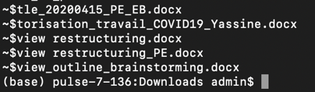
SAGE I timeline
7th semester: 9 sessions
Command line
Scripting
High performance
computing
Nanopore sequencing
Generating complete genomes
Oral exam!
half day
full day
27.9
29.9
4.10
11.10
1.11
8.11
15.11
22.11
29.11
Christmas break
Genome quality check
Genome annotation
Illumina sequence
data processing
Genome assembly and analysis

Slide 11
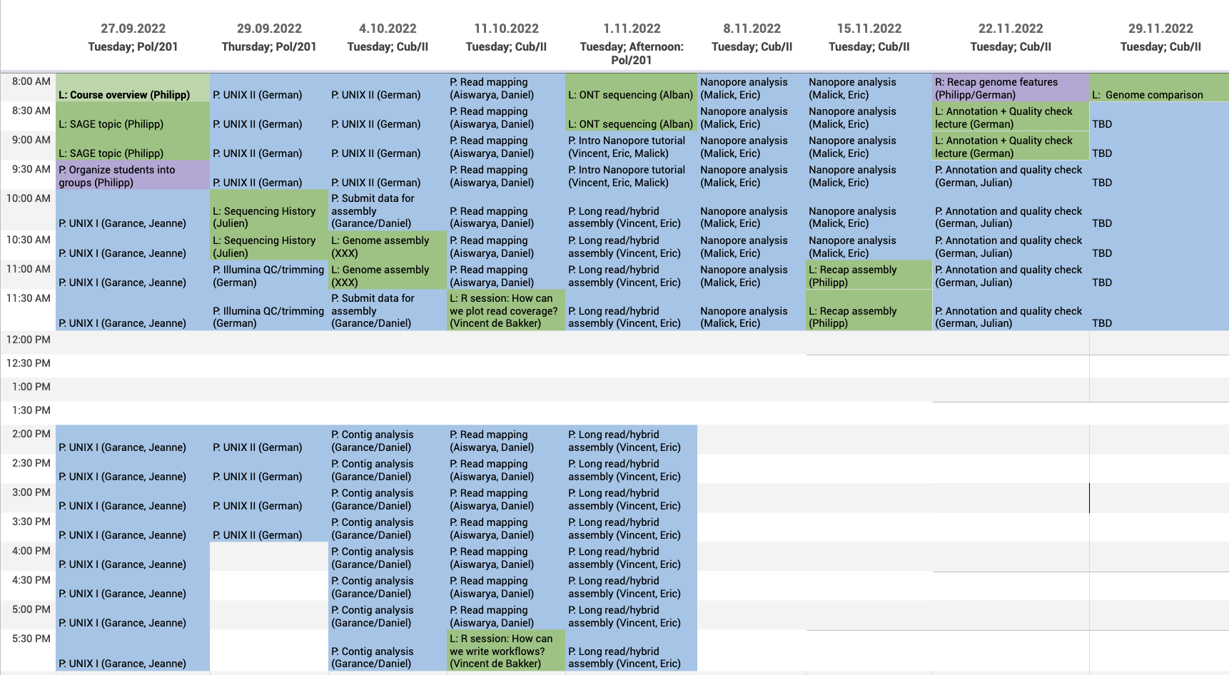
Detailed schedule - SAGE I
Alban Ramette, Uni Bern
Julien Marquis,
Genome facility, UNIL
Schedule can be found on google spreadsheets!
https://docs.google.com/spreadsheets/d/17rel-XigS9XZC6VTc0b30PYGt2Xo29wCDRi6otIkqwU/edit?usp=sharing

Slide 12
Outlook 8th semester
SAGE II
Presentation
8th semester
Report
April-June
Community-wide analyses
Metagenomics sequencing

Slide 13
Some important notes
This course is different from others!
Training-through-research: no “cook book” teaching
Every two years a new research topic:
Huge amount of preparation on our side!
Exciting but challenging: we don’t know the results in advance!
Schedule may change depending on problems we face
Some “ad hoc” solutions may need to be found…
Organization will not be perfect!
Every assistant has a different background
My recommendation for students and assistants:
Be patient with each other, be spontaneous and pro-active!

Slide 14
How to keep us/you happy?
Participate! Open your mouth, give your opinion, say it when something displeases you
Classes are obligatory; classes start at a fix time (8h00 or 13/14h15)
Short rehearsal every class (“where do we stand”?)
We do not judge on your preliminary bioinformatics skills!

Slide 15
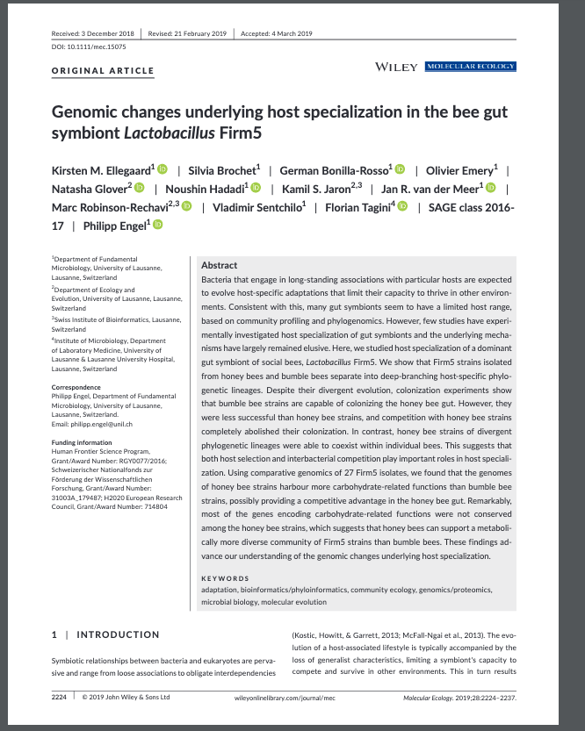
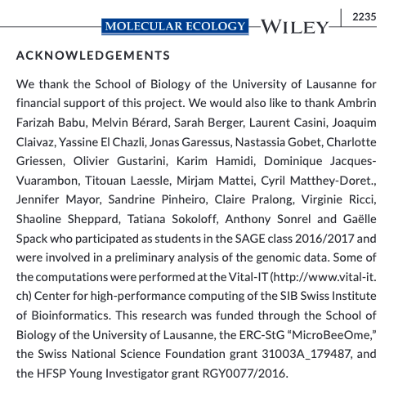
SAGE publications?

Slide 16
Research should be documented/reproducible
Take a lab notebook specifically for this class
Make sure all your data are in one folder and properly labeled
Make sure to add small text files describing details of what you did (e.g., use of programs, literature, settings, databases, etc.): Readme.txt
Dedicate sufficient time for documenting your research
R markdown!

Slide 17
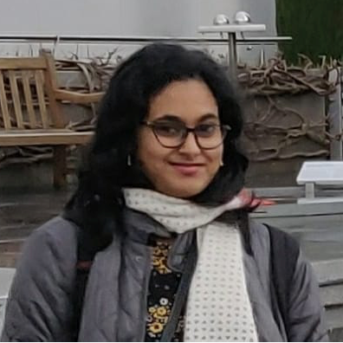
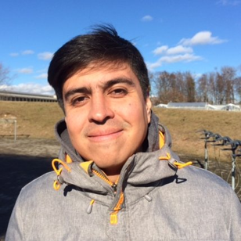
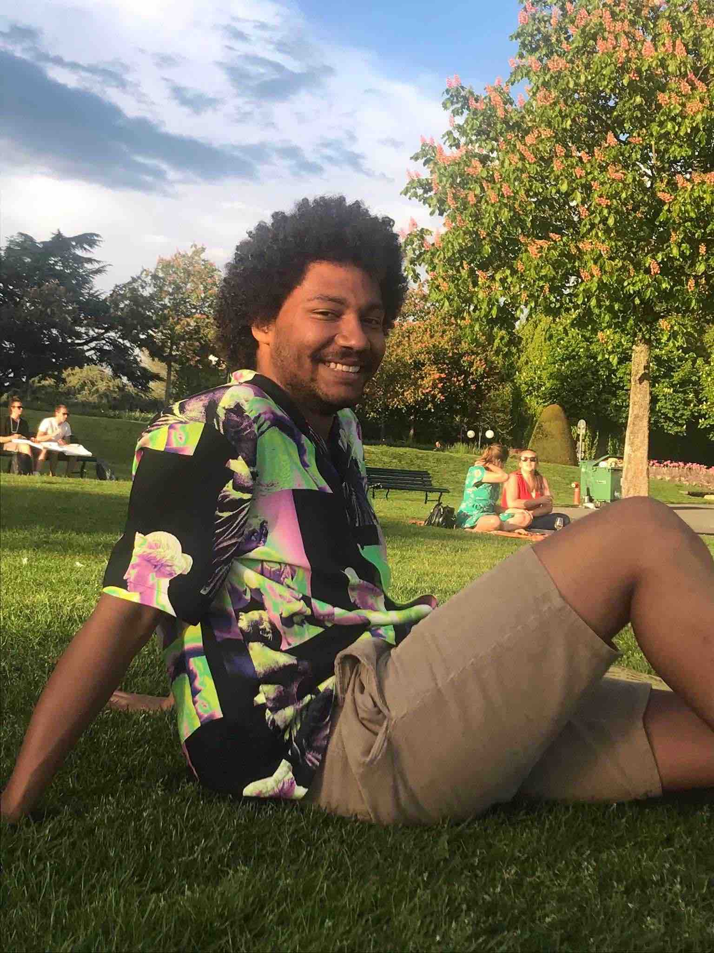
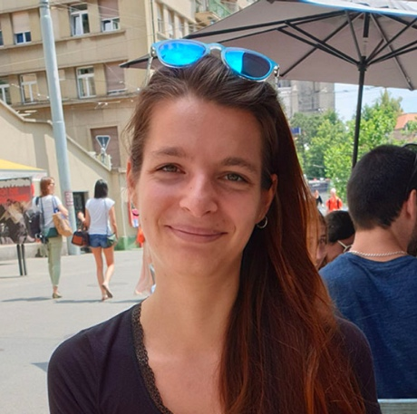
Your assistants
Aisarya
Prasad
Eric
Ulrich
German
Bonilla-Rosso
Mam Malick
Sy Ndiaye
Jeanne
Tamarelle
Julien
Garneau
Daniel
Garrido Sanz
Garance
Sarton-Lohéac
Vincent de Bakker
Philipp Engel

Slide 18
You will work in groups of 3 students
Same groups for the rest of the course!
We aim for 6 groups
1-2 assistants are assigned to each group!
Define groups here:
https://docs.google.com/spreadsheets/d/17rel-XigS9XZC6VTc0b30PYGt2Xo29wCDRi6otIkqwU/edit?usp=sharing

Slide 19
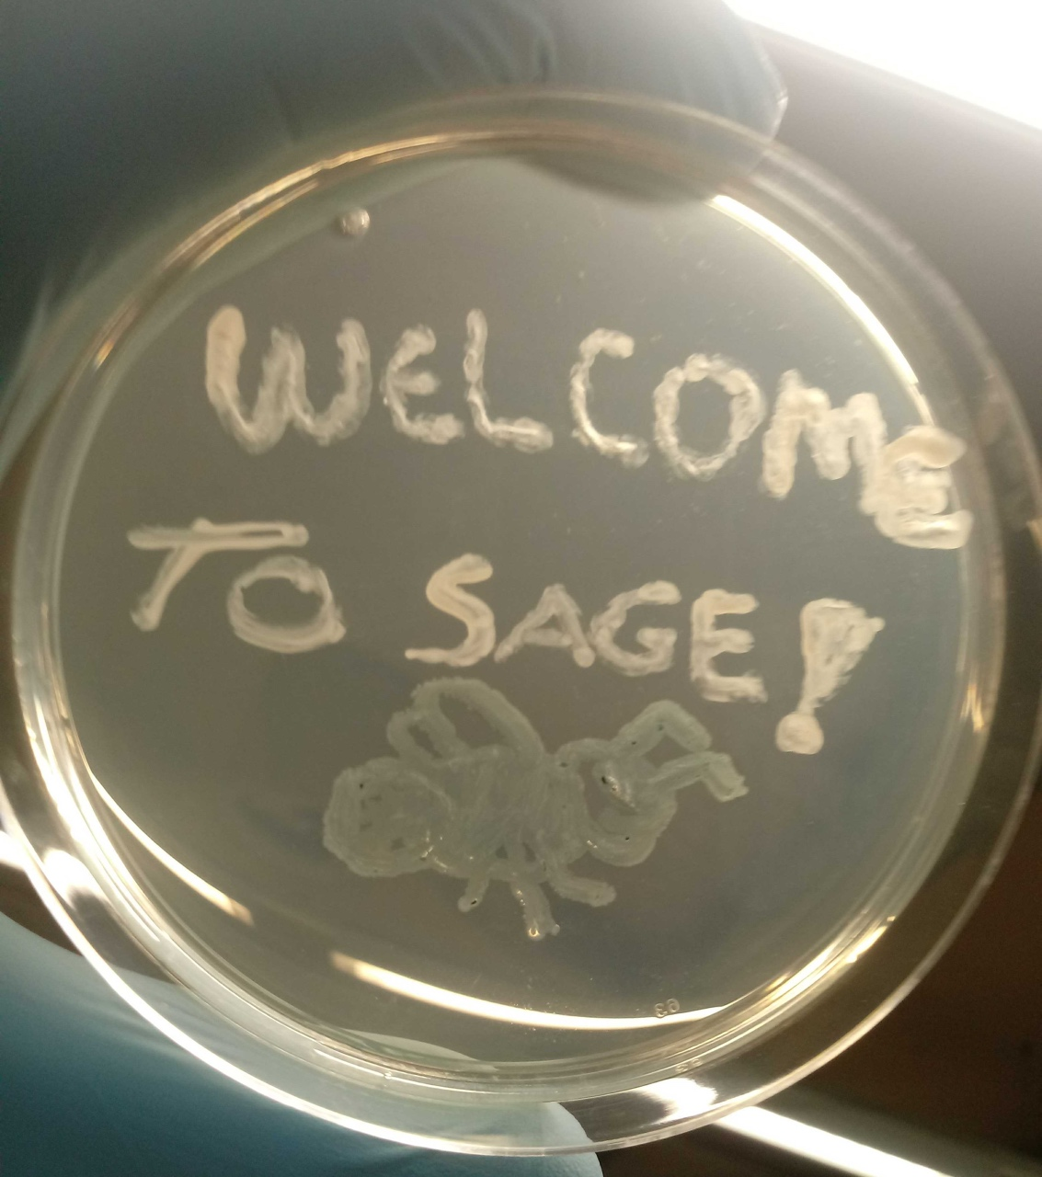
Questions?
Carlos Gustavo
Nunes da Silva

Slide 20
Coffee break!!!

Slide 21
SAGE 2022-23
Our research topic
Water kefir
https://revolutionfermentation.com/

Slide 22
Our topic: Water kefir microbiota
Water kefir: A fermented, fizzy drink
Lactic acid bacteria
Yeasts
Some others
Sugars
Fermentation
Acids, alcohol
https://revolutionfermentation.com/

Slide 23
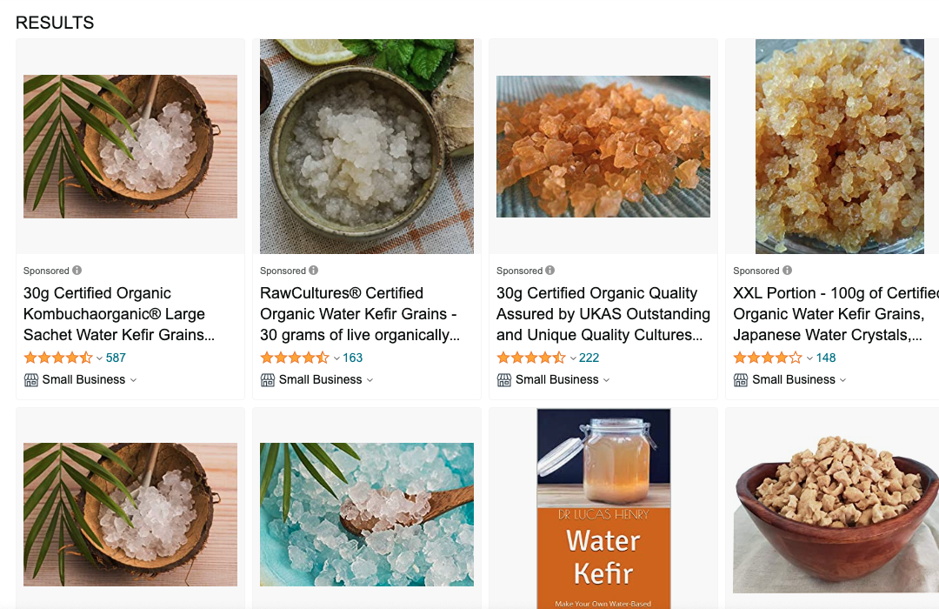
Our topic: Water kefir microbiota
https://revolutionfermentation.com/

Slide 24
Food microbiology
The microbiota of animals
Food microbiology =
study of microorganisms that inhibit, create, or contaminate food
Inhibit: Pathogens of crop plants or farm animals
Create: Biotransformation (mostly fermentation) - a natural way to improve the flavor, digestibility and/or shelf life of food
Contaminate: Microbial growth in food that changes flavor, odor, and general quality food with implications for human health when ingested

Slide 25
Biotransformation via fermentation
The microbiota of animals
Bread
Beer
Wine
Vinegar
Cheese
Chocolate
Coffee
Idly
Sauerkraut
Kimchi
Natto
Meats
Kombucha
Miso

Slide 26
Why study fermented foods?
The microbiota of animals
Human health
Probiotic effects of microbes in fermented food?
Food safety
Food industry
Creation of new foods and flavors by microbes; Preservation
Microbial ecology and evolution
→ Basic understanding of microbial communities

Slide 27
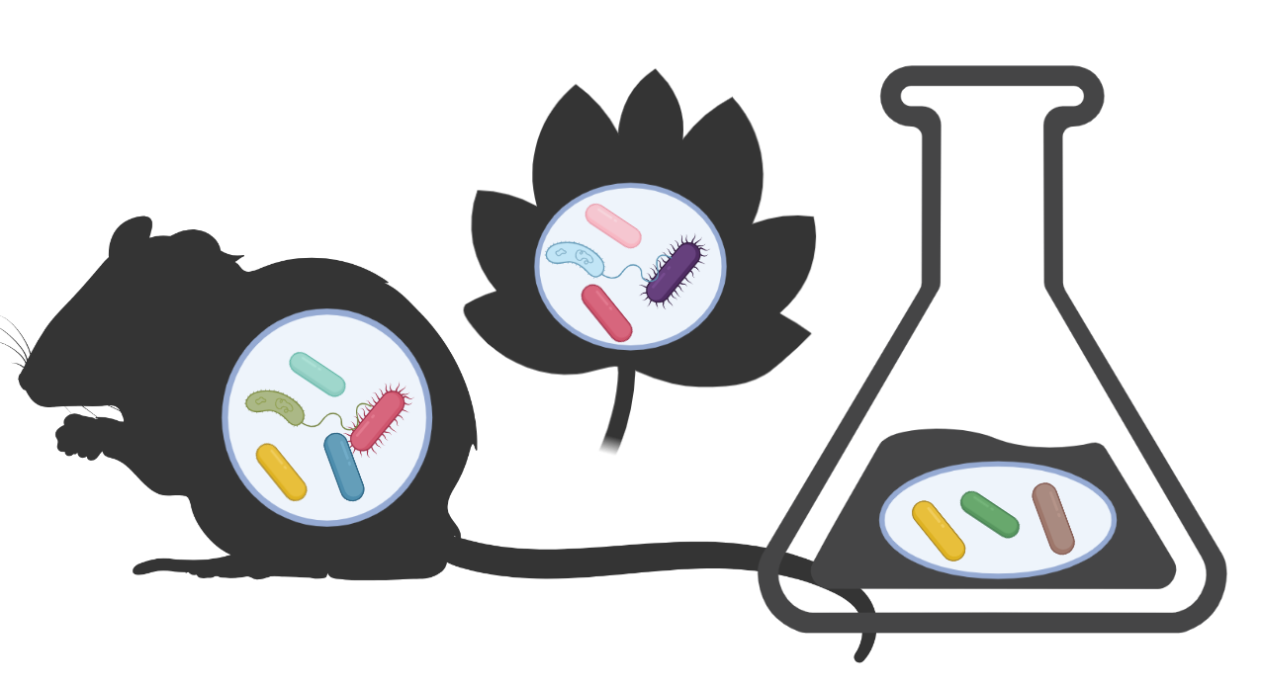
Understanding microbial ecosystems
The microbiota of animals
Natural microbial communities
Synthetic communities
https://www.smartchain-h2020.eu/2021/04/13/soil-health/
Simple and tractable
But
Artificial
Functionally distinct from natural communities
Important functions
Functionally stable and specific
But
Highly complex (diverse and variable)
Many microbes not culturable
Difficult to study in the lab

Slide 28
Fermented Foods as Experimentally tractable microbial ecosystems
The microbiota of animals
Environment
reproducible
Limited
diversity
Often
culturable
Functionally stable
Ancient
General questions
about microbes:
How do communities assemble?
What determines robustness of a community?
Which species has which role?
How do bacteria interact in communities?
Do they adapt to each other and co-evolve?
How do abiotic factors impact the community?

Slide 29
Water kefir
Who?
What?
How?
https://revolutionfermentation.com/

Slide 30
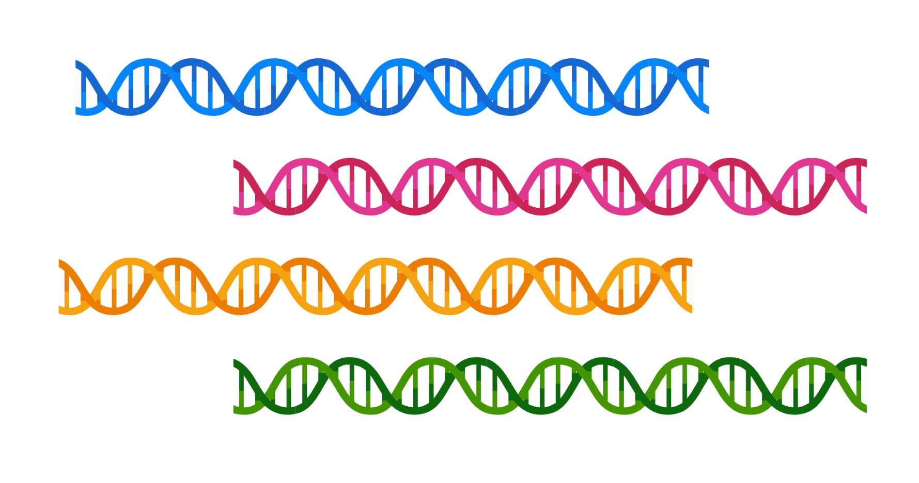
Next-generation sequencing to analyze microbial diversity
The microbiota of animals
Illumina
Pacbio
Nanopore
Who is there?
What are they doing?

Slide 31
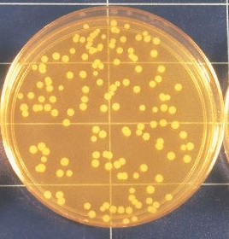
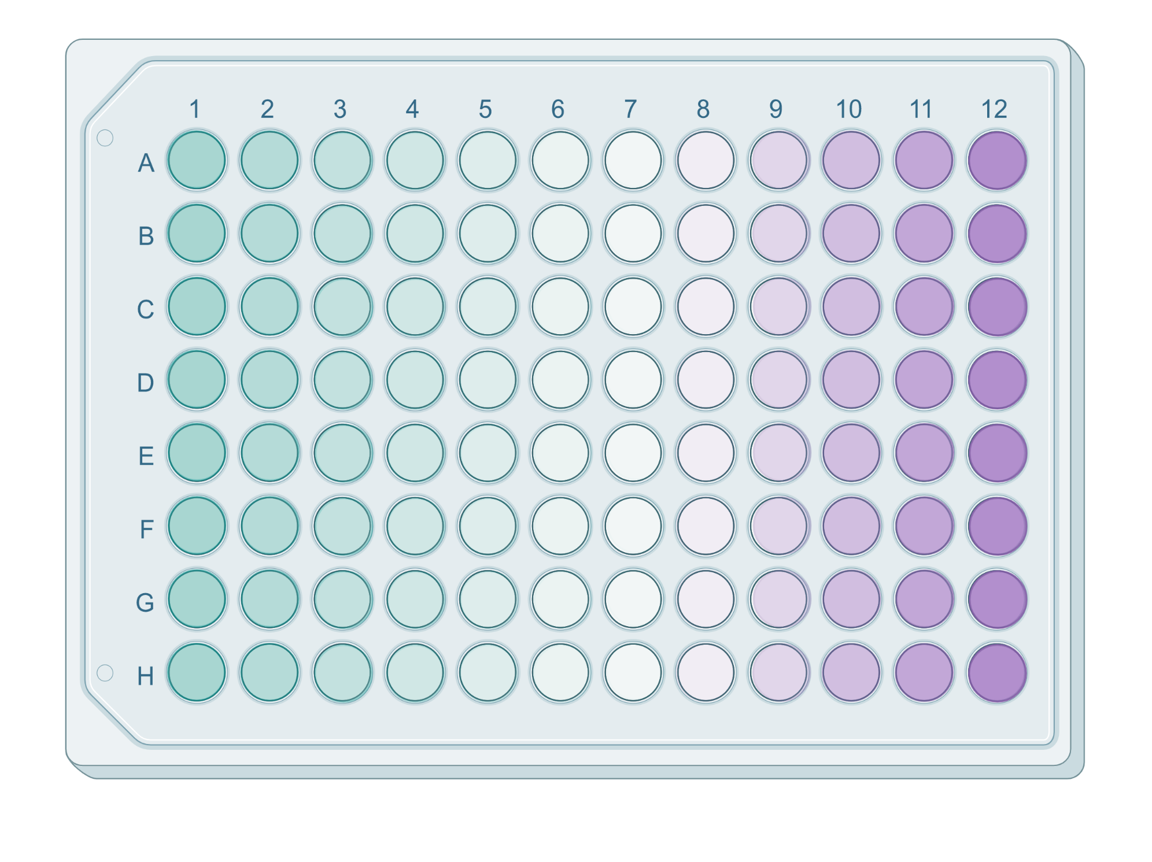
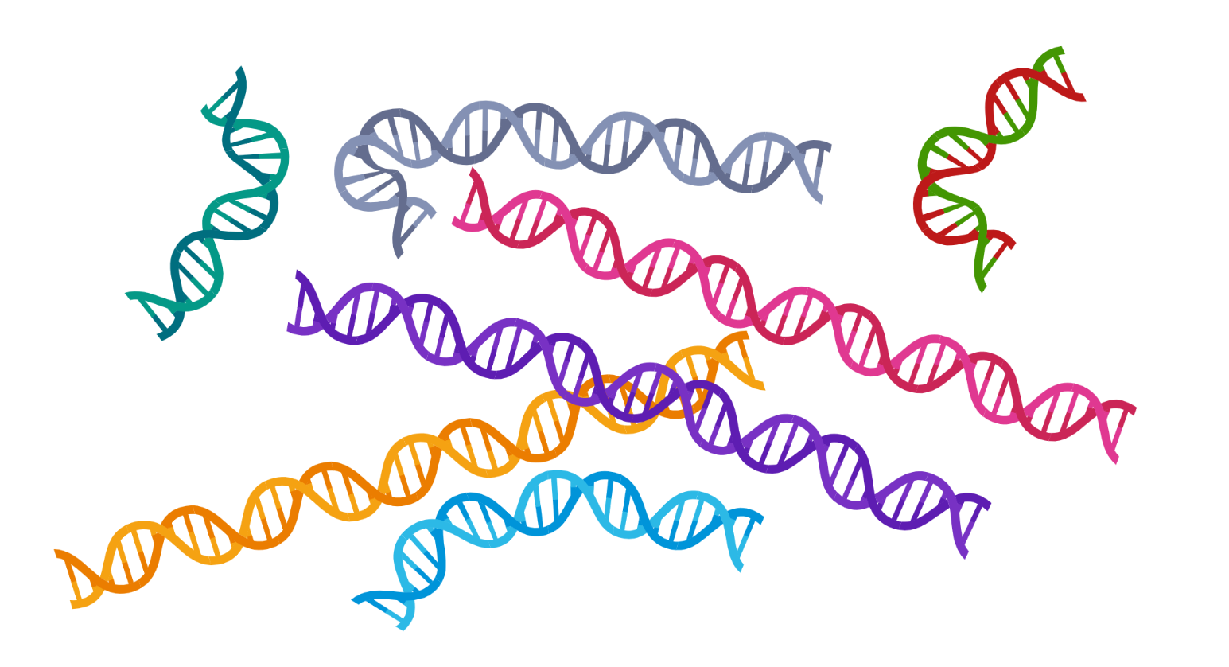
Next-generation sequencing to analyze microbial diversity
The microbiota of animals
SAGE 1
Culture-
dependent
Culture-
independent
SAGE 2
Isolate genomes:
One bacterium at a time
Not comprehensive
Very precise and accurate
Metagenomes
Entire community at a time
Comprehensive
Less precise

Slide 32
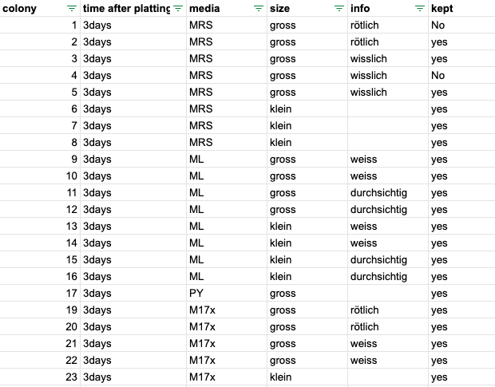
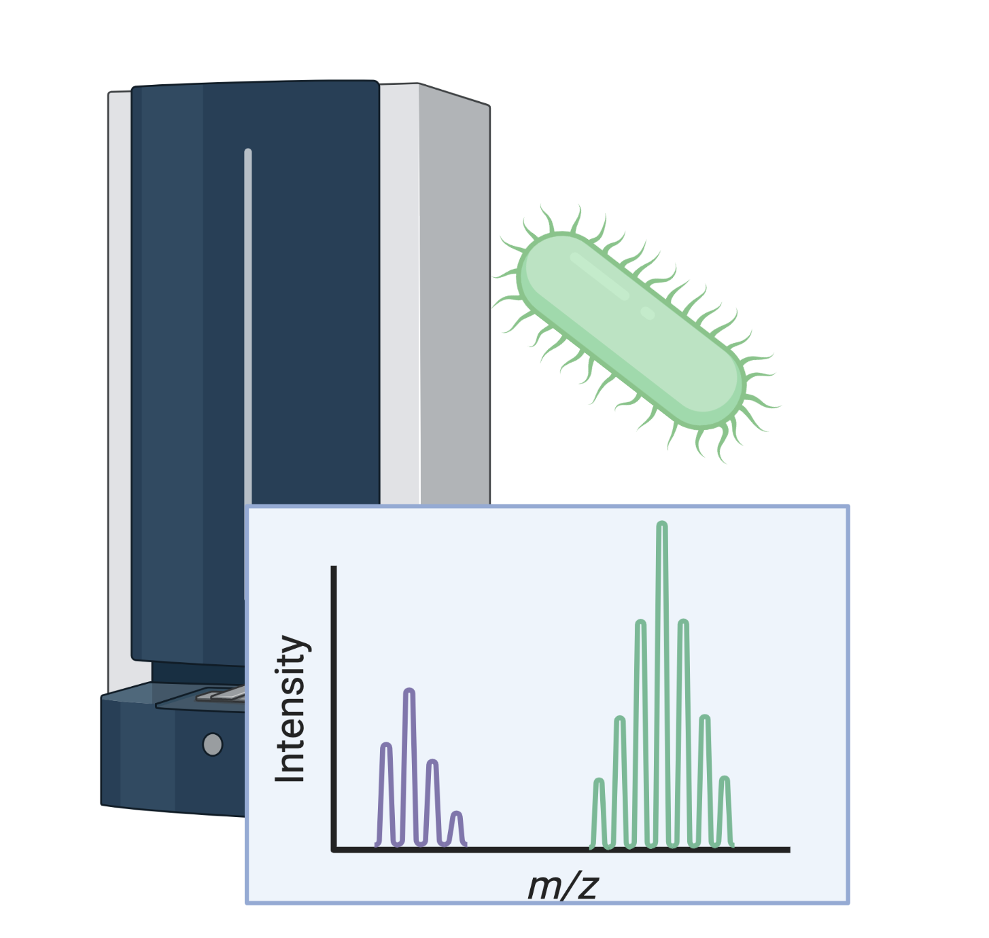
SAGE 1 - Preliminary work
The microbiota of animals
Homogenization
Vincent
Somerville
Strain collection
Plating
Blender/
Homogenizer
Identify bacteria
8 culture media
Anaerobic
3-8 days
Illumina
Genome
sequencing
Maldi-TOF/
16S rRNA genotyping

Slide 33
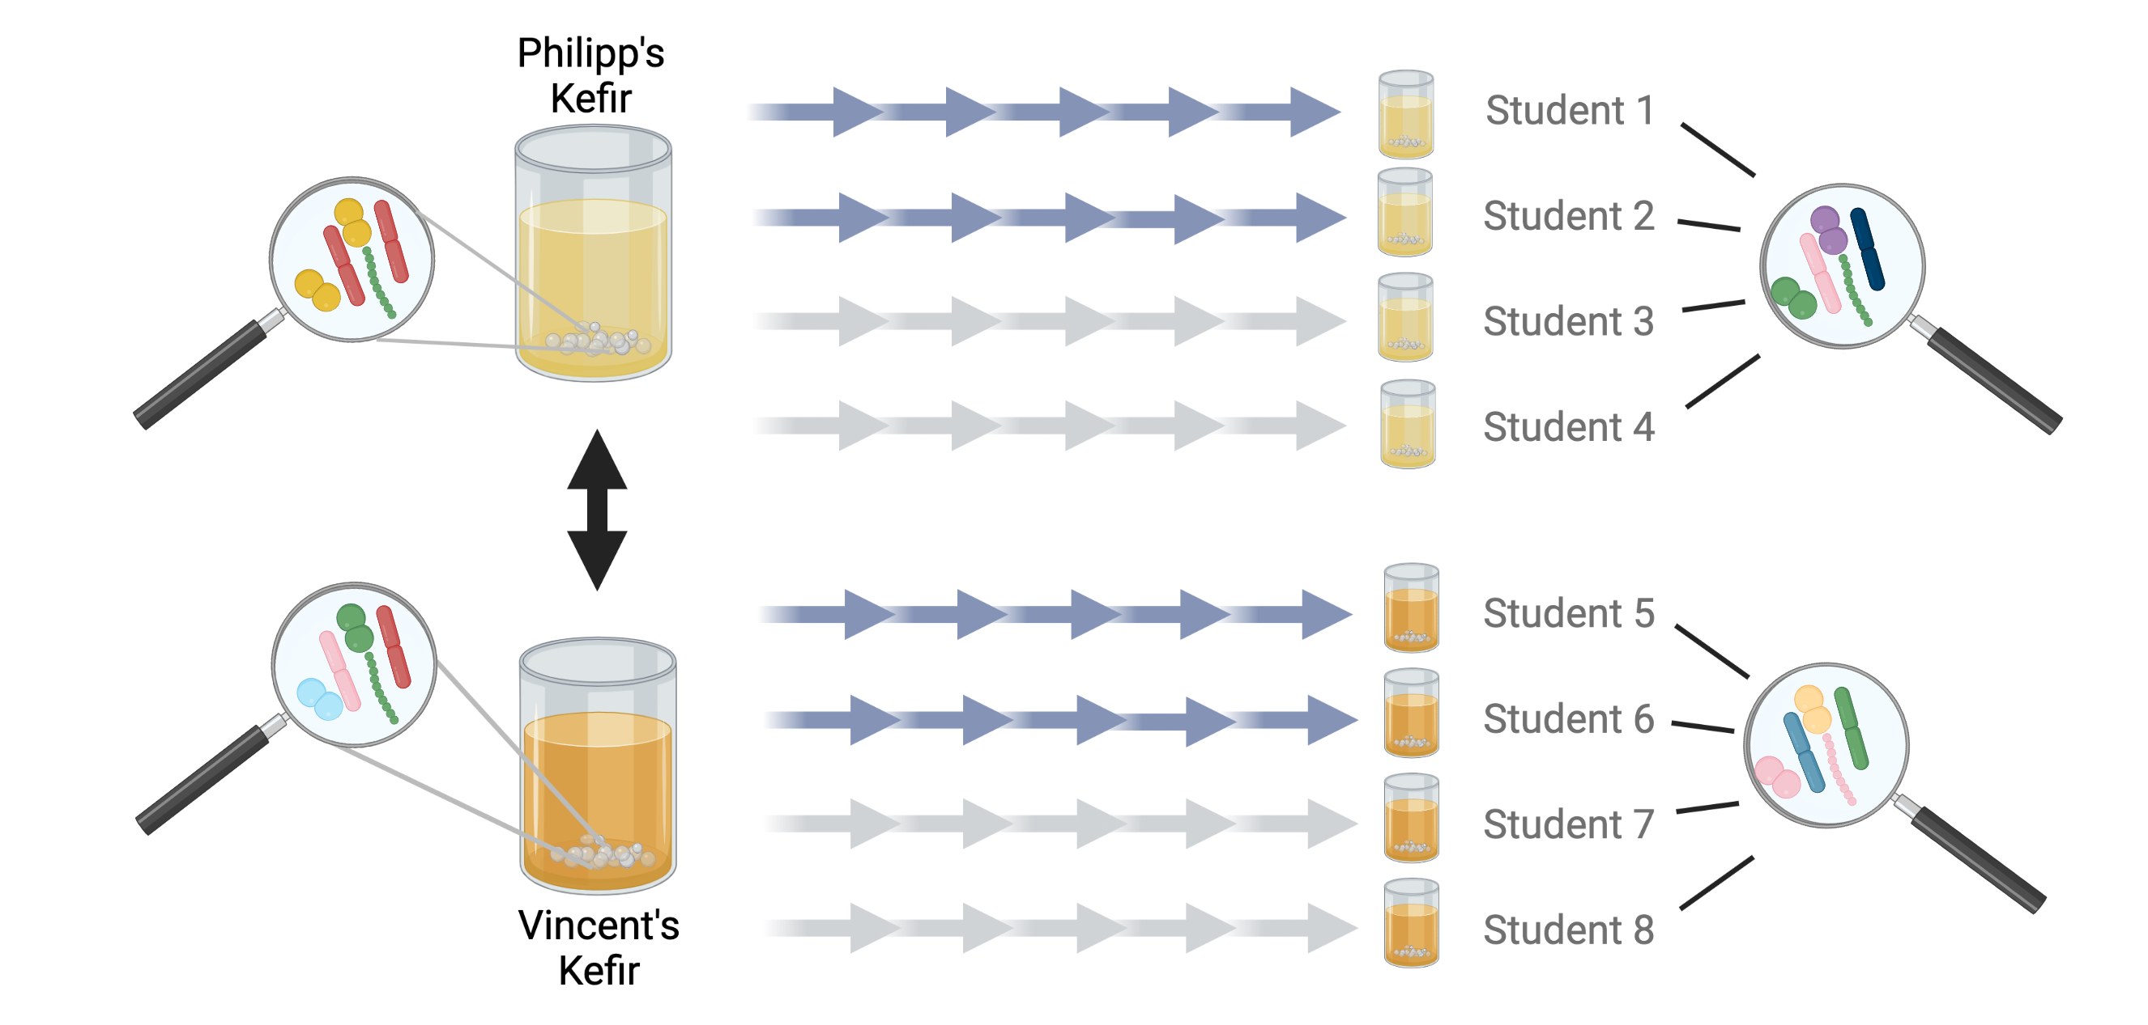
SAGE 2 - Outlook
The microbiota of animals
Question 2
Dried figs
Raisins
Question 1
Question 3
Dried figs
Raisins
Question 1: How similar are the communities in the two kefir starter cultures?
Question 2: How stable are the communities over time?
Question 3: Do they change in response to the environment?

Slide 34
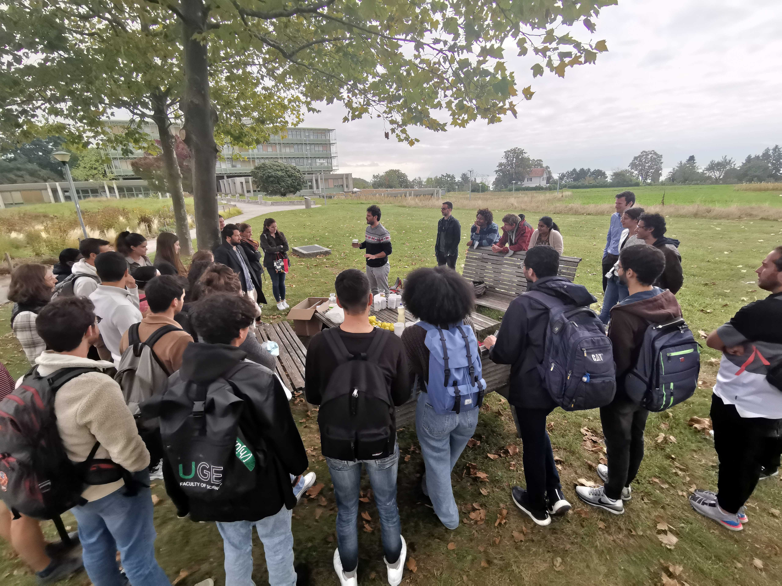
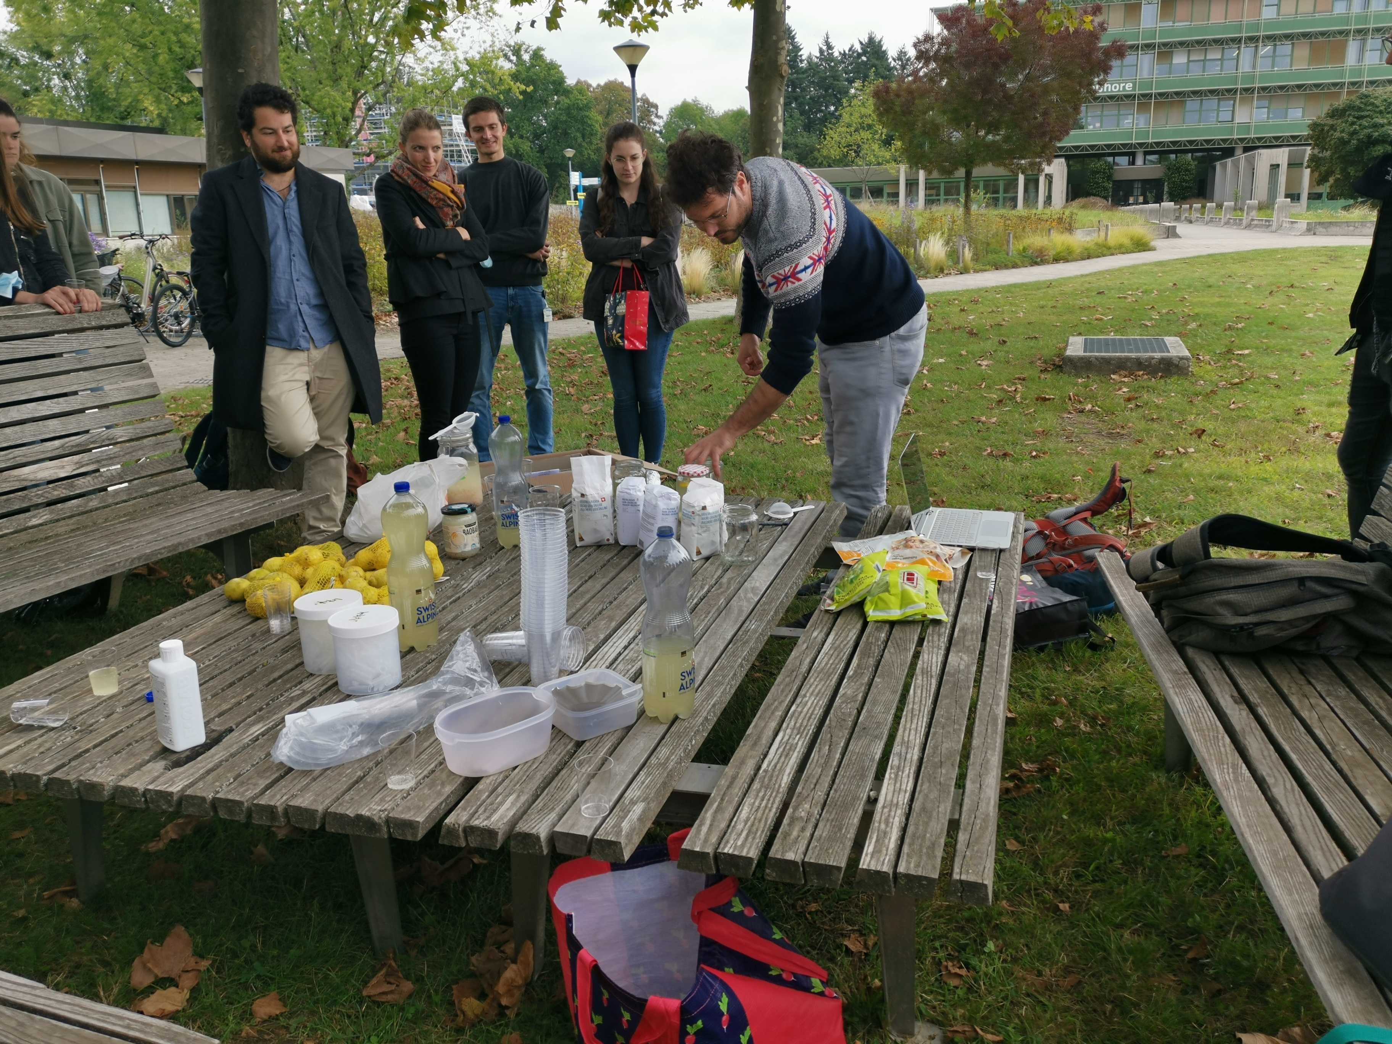
SAGE 2 - Outlook
The microbiota of animals

Slide 35
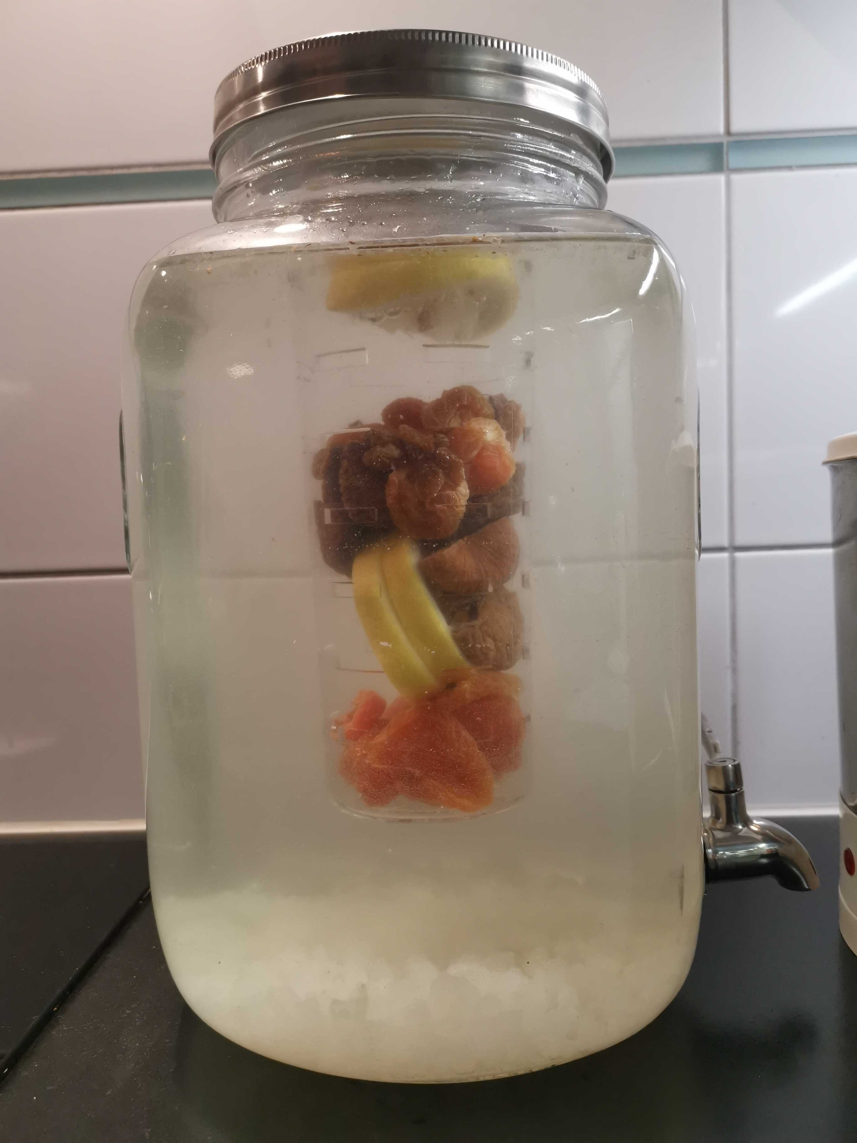
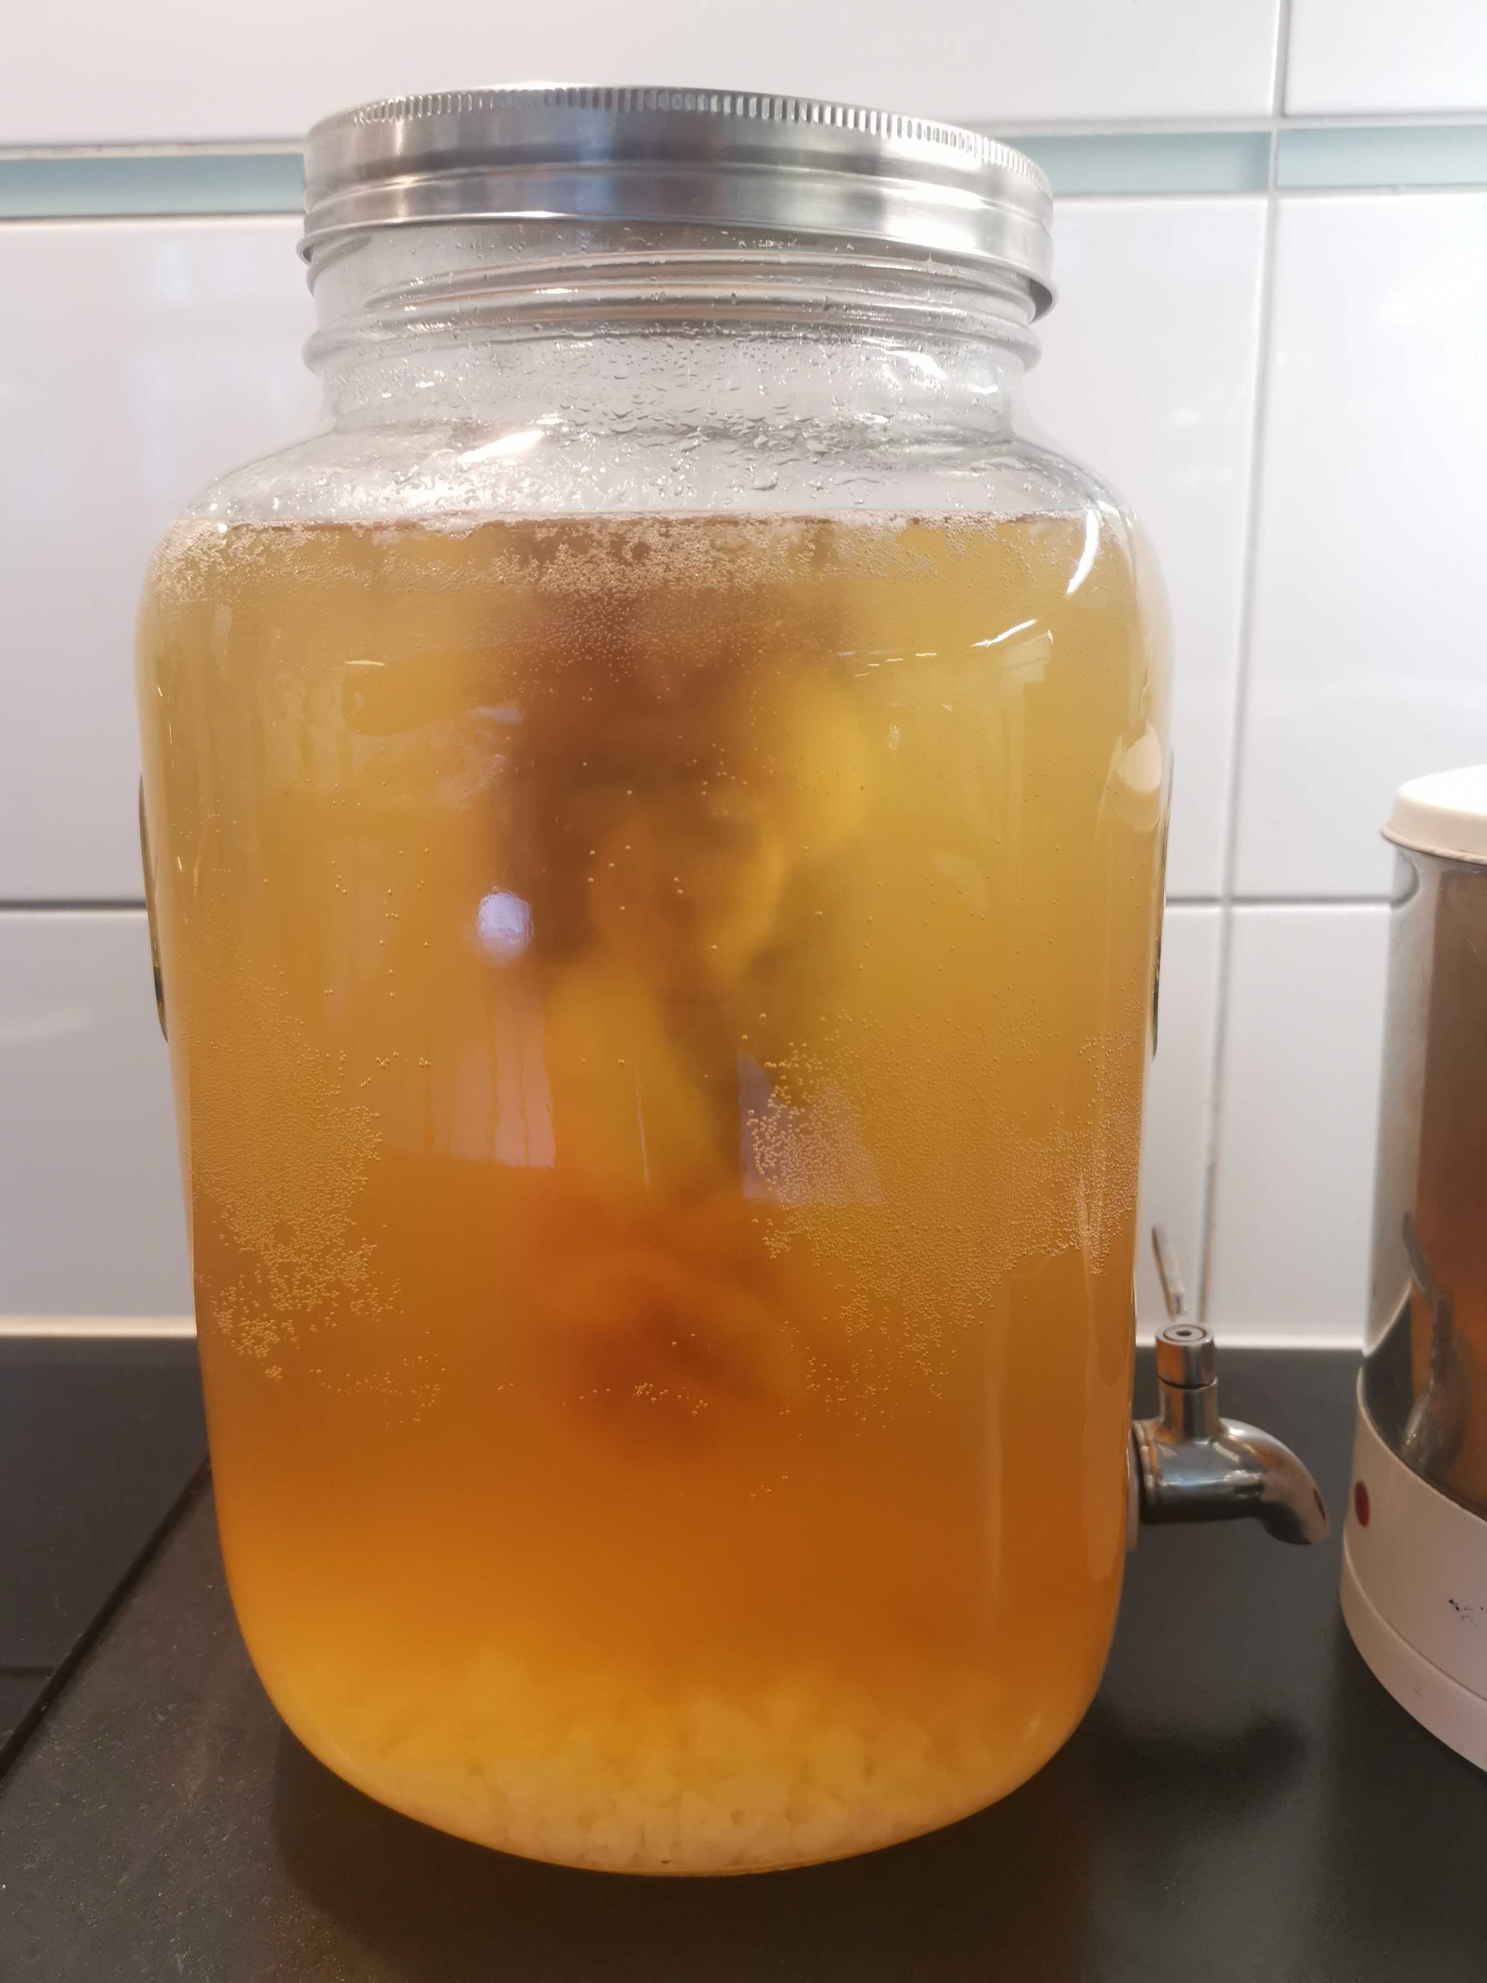
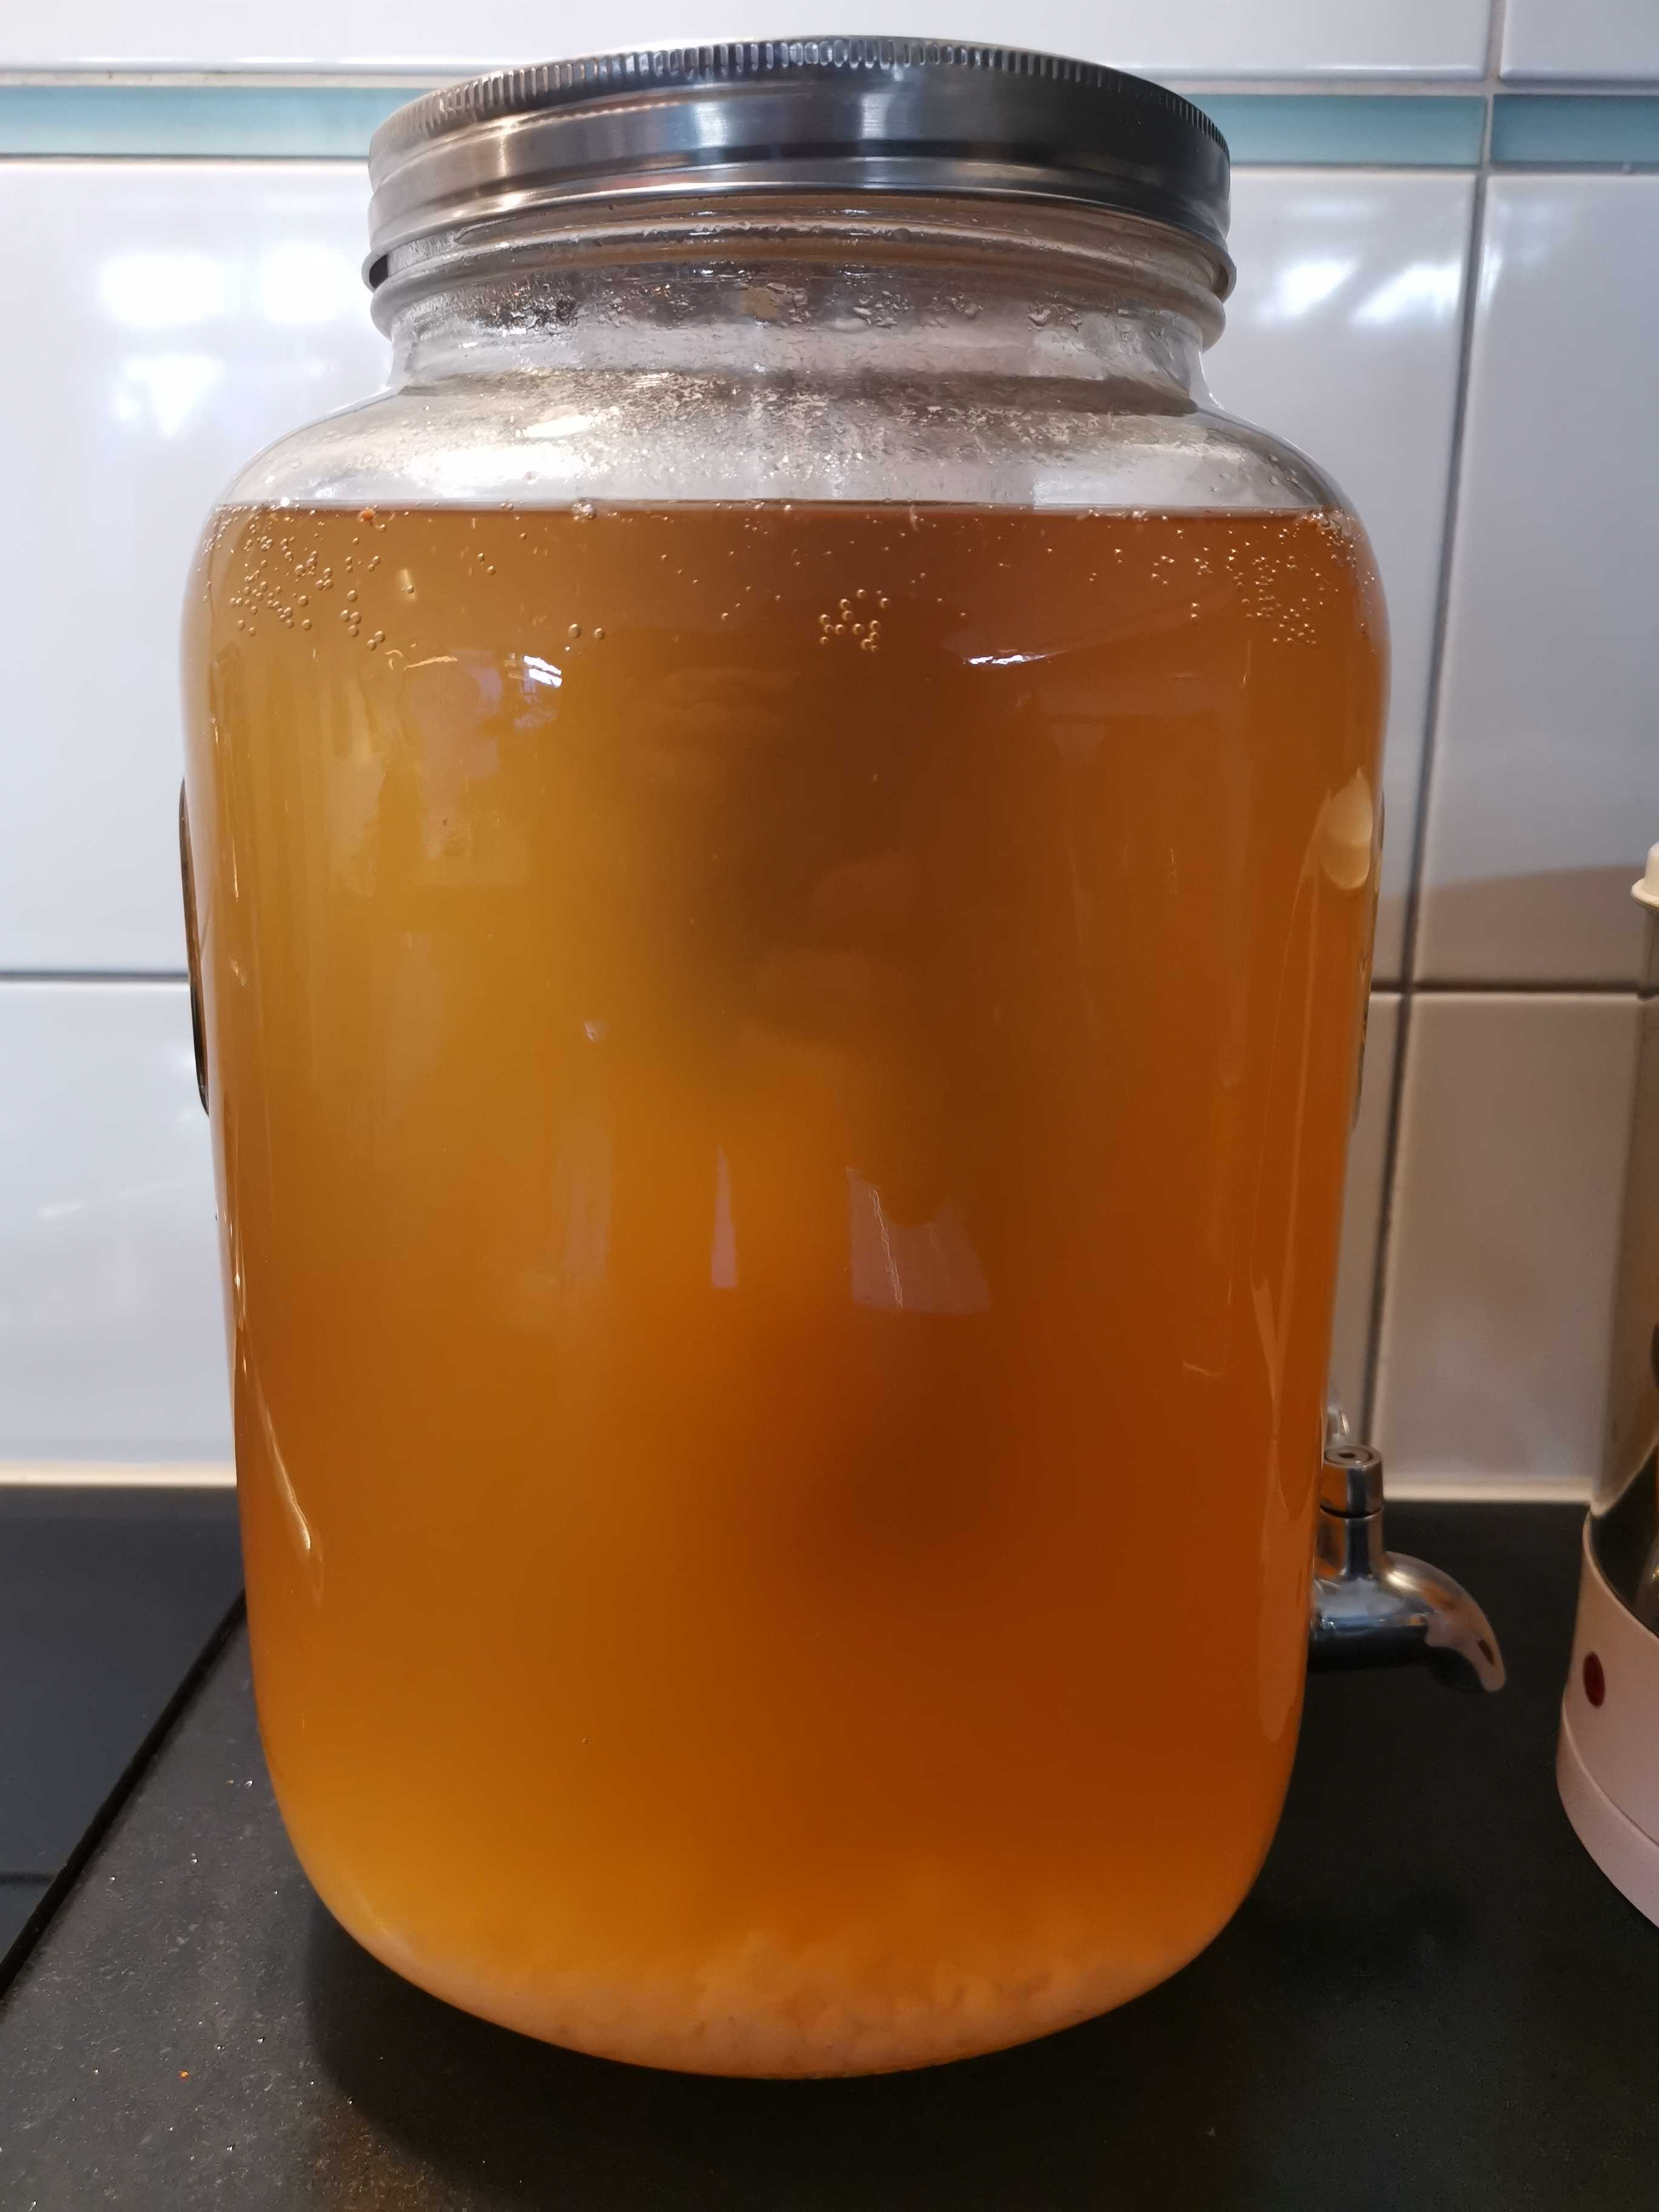
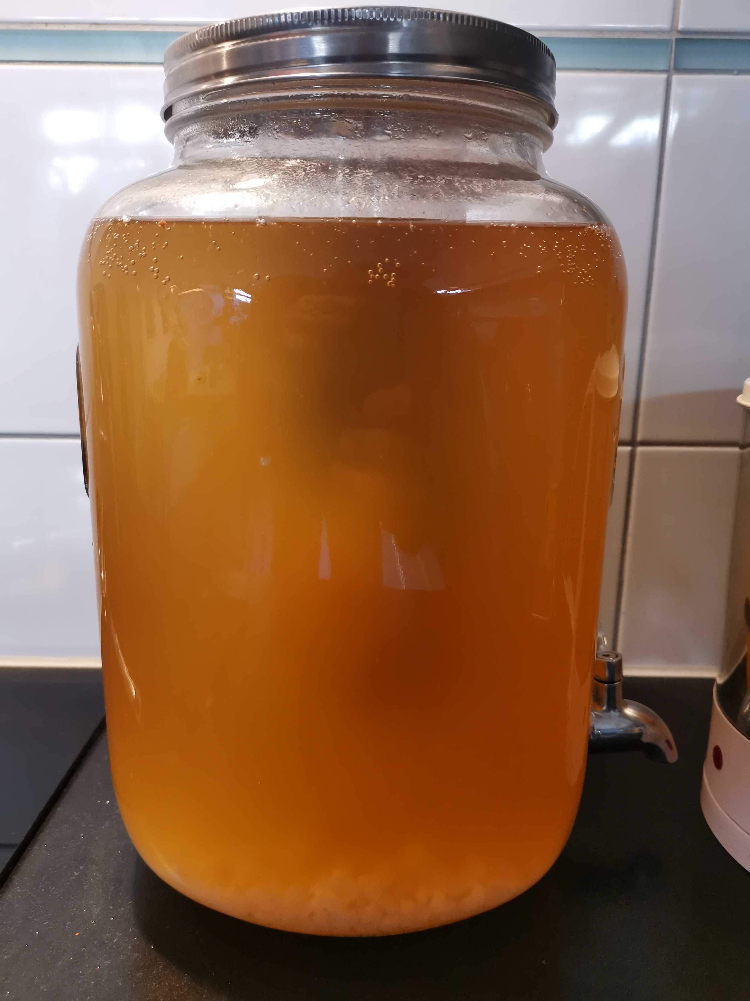
A typical water kefir fermentation
The microbiota of animals
0h
12h
24h
36h
→ Fill in bottles
→ 2nd fermentation in closed bottle at RT
→ Fridge

Slide 36
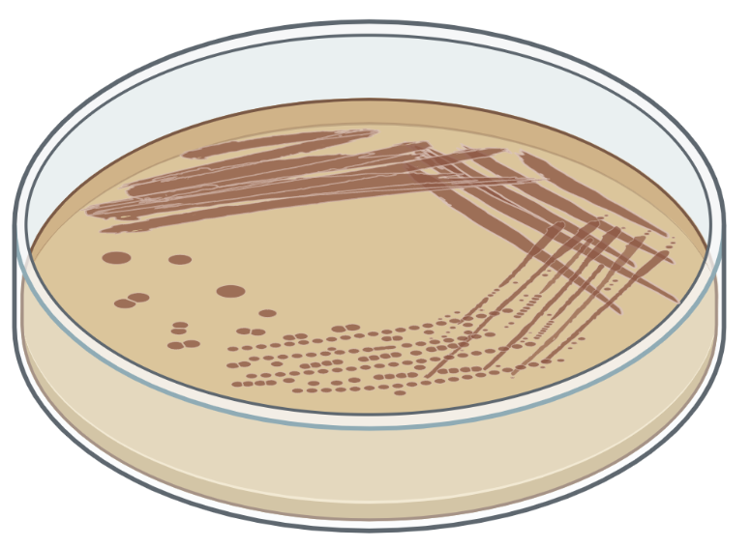
SAGE 1 - Preliminary work
The microbiota of animals
Grow bacterial isolate
Vincent
Somerville
Julien Marquis,
Genome facility, UNIL
Fw
DNA libraries
Rv
Vazyme FastPure Bacteria
DNA Isolation Mini Kit
MiSeq v2
2x250bp
Paired-end
Illumina Nextera Flex DNA library prep
2 Files (fastq format)
File 1: Fw reads (250 bp)
File 2: Rv reads (250 bp)

Slide 37
SAGE I timeline
New sequence data!
7th semester: 9 sessions
Command line
Scripting
High performance
computing
Nanopore sequencing
Generating complete genomes
Oral exam!
half day
full day
16.9
23.9
29.9
23.10
27.10
3.11
10.11
17.11
24.11
Christmas break
New sequence data
Genome quality check
Genome annotation
Illumina sequence
data processing
Genome assembly and analysis

Slide 38
Slack and VPN
Instant messenger
UNIL network
Curnagl
(When working from at home)

Slide 39
Questions?

Slide 40
Coffee break!!!

